Slide 1


Bootstrap 4 From Scratch With 5 Projects
What’s New In Bootstrap 4?

Slide 2
Sass CSS Pre-Compiler
Moved from Less to Sass
As of v3 a Sass port was created and maintained
Sass is favored in the web dev community
Use of Libsass to compile faster

Slide 3
Button Styles & Flat Design
Flat style over gradient
More subtle look
More Color Classes
.btn-outline-* class

Slide 4
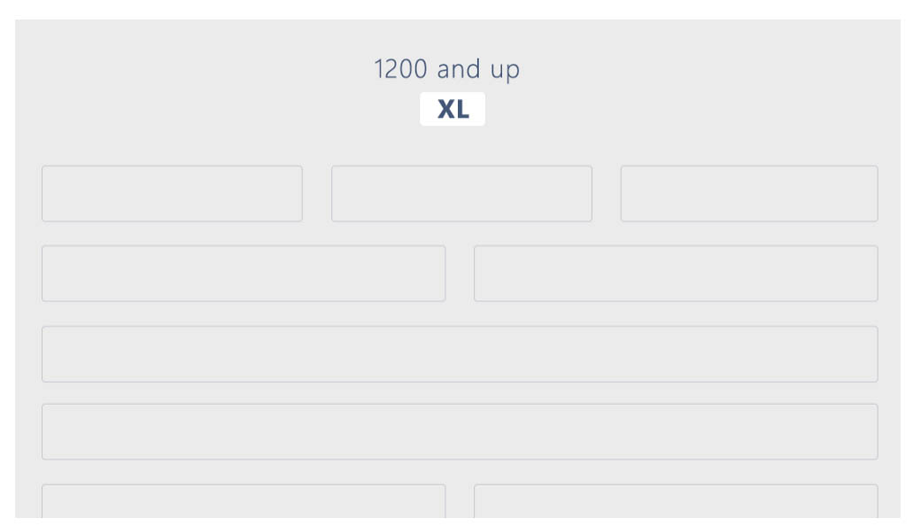
Improved Grid System & Layout
Changes in the underlying architecture
rem & em units instead of pixels
New –xl tier for extra large screens
Grid now uses flexbox
No more “offset-md-x” Now use margin auto classes

Slide 5
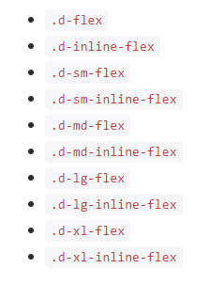
Flexbox
Includes flexbox utilities
Use flexbox to manage grids, navigation, components and more
Display utilities can transform children items into flex items
<div class="d-flex p-2">I'm a flexbox container!</div>

Slide 6
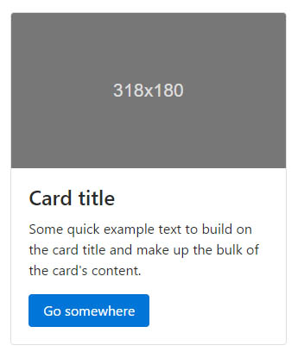
Cards
Cards replace panels, wells and thumbnails
Uses flexbox
Get same behavior with modifiers
As little markup as possible
.card-body instead of .well
Use .card-title for titles
Image Headings

Slide 7
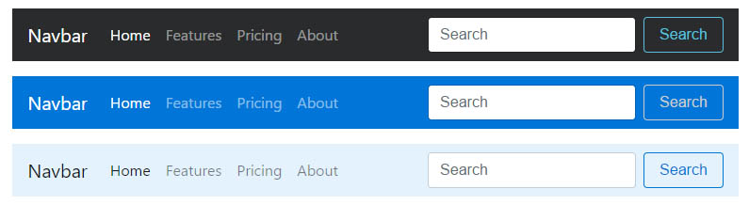
Changes To The Navbar
Flat design
Uses flexbox instead of floats
Wrapping .navbar with .navbar-expand{-sm|-md|-lg|-xl} for responsive collapse
Color Schemes

Slide 8
Form Changes
Dropped the .form-horizontal class
Forms using grids require the .row class and can use .col-form-label for labels
Use .form-control-lg and .form-control-sm to increase or decrease the size of an input control.
Help text now uses the .form-text class instead of .help-block

Slide 9
Some Other Changes
Bigger fonts and headings
Dropped support for IE8 + IE9
Reboot module
Inversed tables (.table-inverse)
Glyphicons dropped (Font-awesome recommended)
Sizing & spacing classes

Slide 10


FOLLOW BRAD:
Youtube.com/c/traversymedia
Facebook.com/traversymedia
Twitter.com/traversymedia
Linkedin.com/in/bradtraversy
Thank You
For Watching!
www.traversymedia.com

